Slide 1


Hands-on GitHub Tutorial
Introduction to Git and GitHub
(06/06/2024)
MGMA_2024

Slide 2
Table of Contents
Git and Github introduction
Git and GitHub instalation
Git and VScode
Git Branch
Forking in git
MGMA_2024

Slide 3
Git and Github introduction
Why you should use Git
To be kind to yourself
To be kind to your collaborators
To ensure your work is reproducible
Spillover benefits
👨‍🔬 📐 It imposes a certain discipline to your programming.
🤓 🔥 You can be braver when you code: if your new feature breaks, you can revert back to a version that worked!
👩‍💻 🗳 Keeps multiple (older and newer) versions of everything (not just source code)
MGMA_2024

Slide 4
Git and GitHub
Git
the software that allows us to do version control.
like the “Track Changes” feature from Microsoft Word, but more rigorous, powerful, and scaled up to multiple files.
GitHub
hosting service for git projects — essentially Dropbox for git projects.
You can host remote repositories on https://github.com/. You edit and work on your content in your local repository on your computer, and then you send your changes to the remote.
You can interact with Git using the Graphical User Interface (GUI) provided by GitHub Desktop, or through the Command Line Interface (CLI).
In this tutorial, we will use both.
https://docs.github.com/fr/get-started/using-git/about-git
MGMA_2024

Slide 5
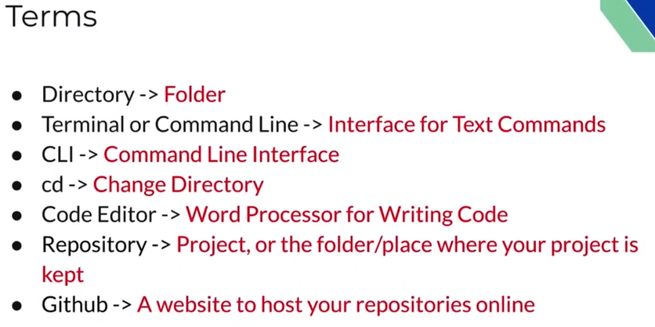
Git and Github introduction
MGMA_2024

Slide 6
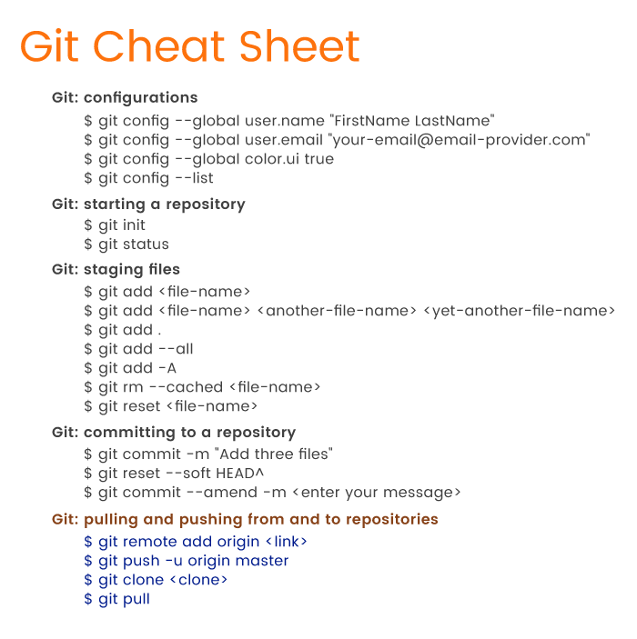
Commands
Git and Github introduction
MGMA_2024

Slide 7
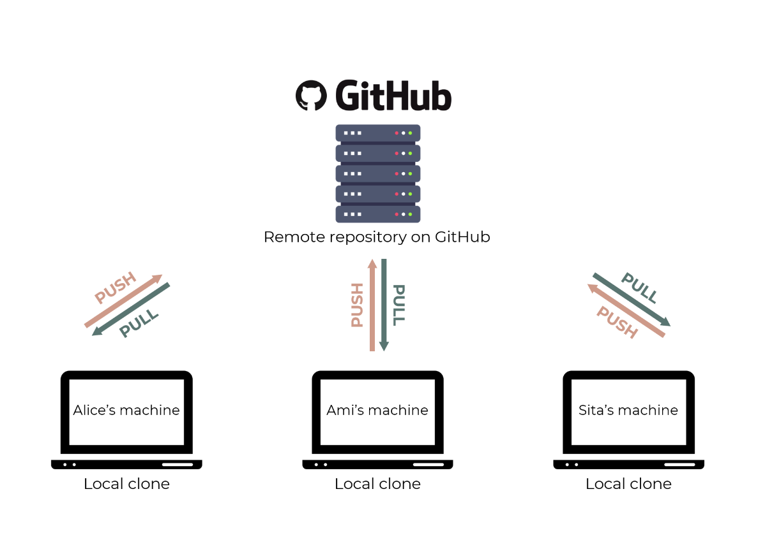
Git and Github introduction
MGMA_2024

Slide 8
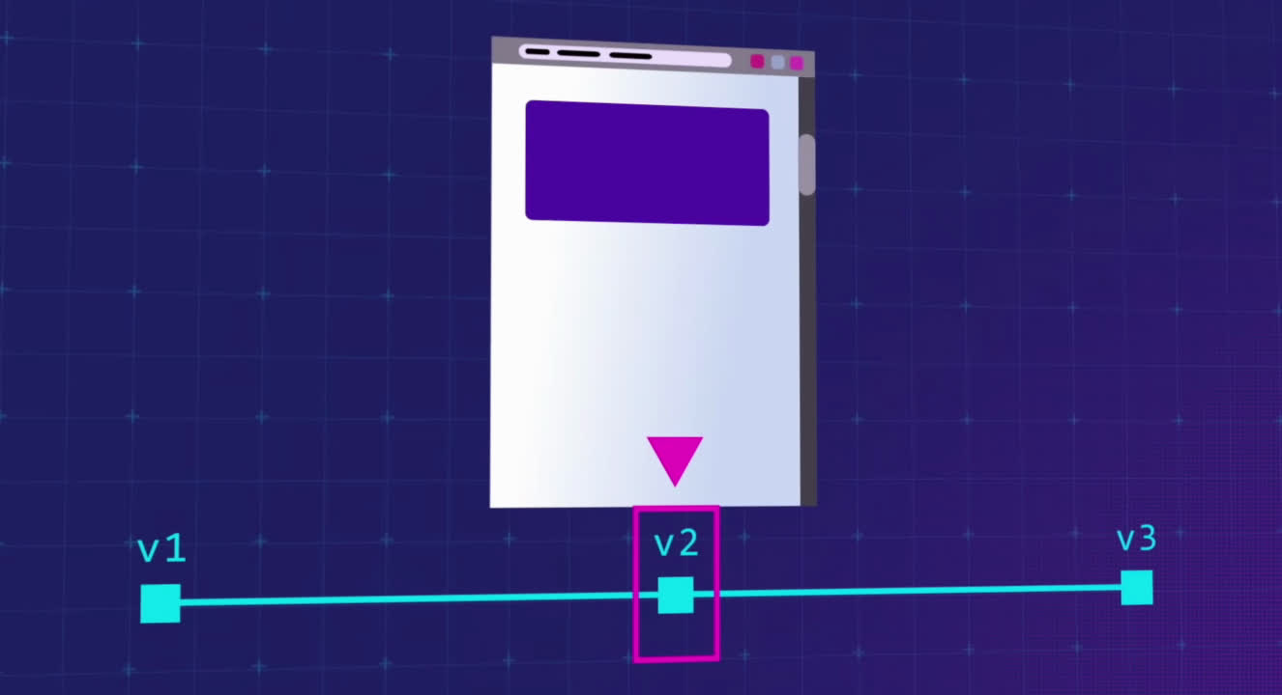
Git and Github introduction
Revert back to the last working stage
MGMA_2024

Slide 9
Table of Contents
Git and Github introduction
Git and GitHub instalation
Git and VScode
Git Branch
Forking in git
MGMA_2024

Slide 10

Git and Github instalation
Github walkthrough
MGMA_2024

Slide 11

Git and Github instalation
Git installation
Installation (CLI)
Git for Windows
https://gitforwindows.org/
MacOS
https://tinyurl.com/git-mac
(Alternate: brew install git)
MGMA_2024

Slide 12
Commands
Git and Github instalation
MGMA_2024

Slide 13
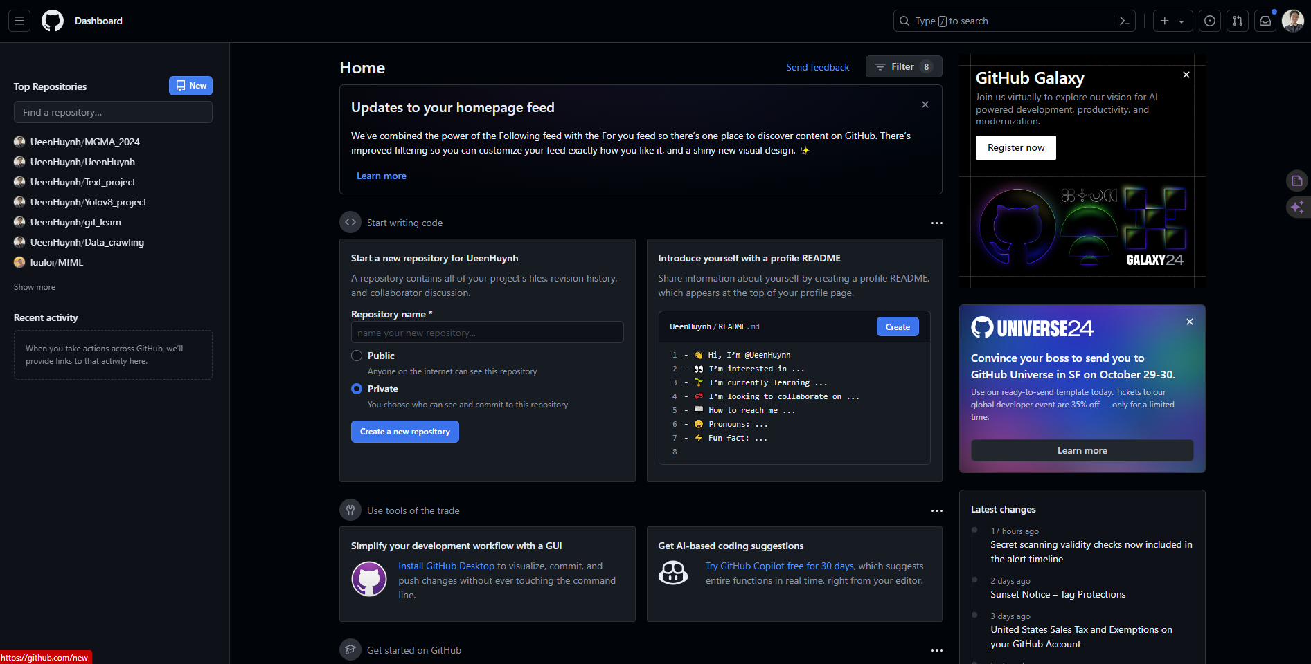
MGMA_2024

Slide 14
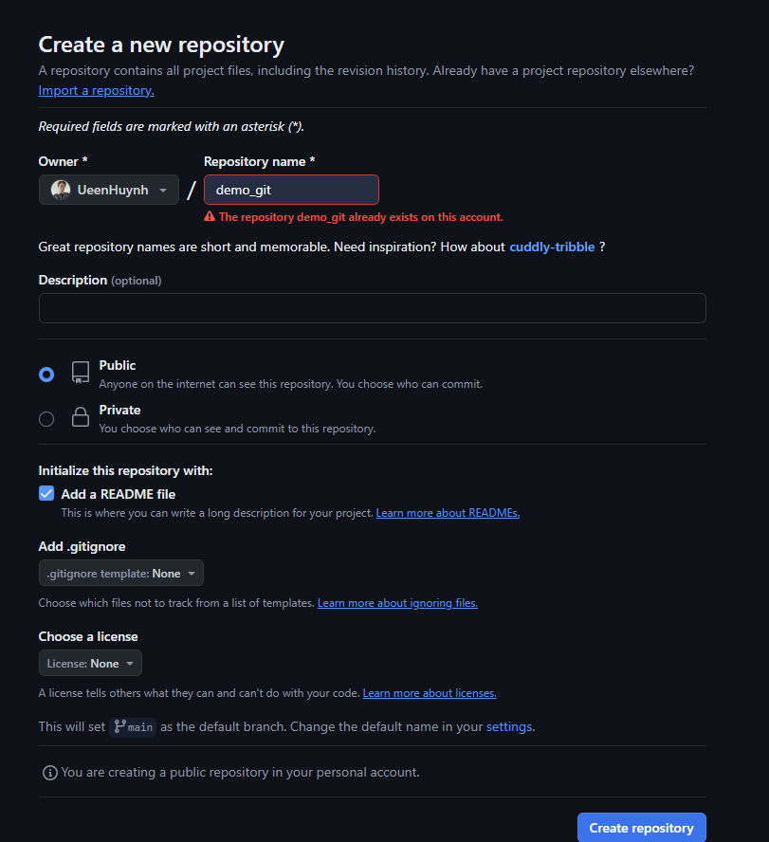

Git and Github instalation
MGMA_2024

Slide 15
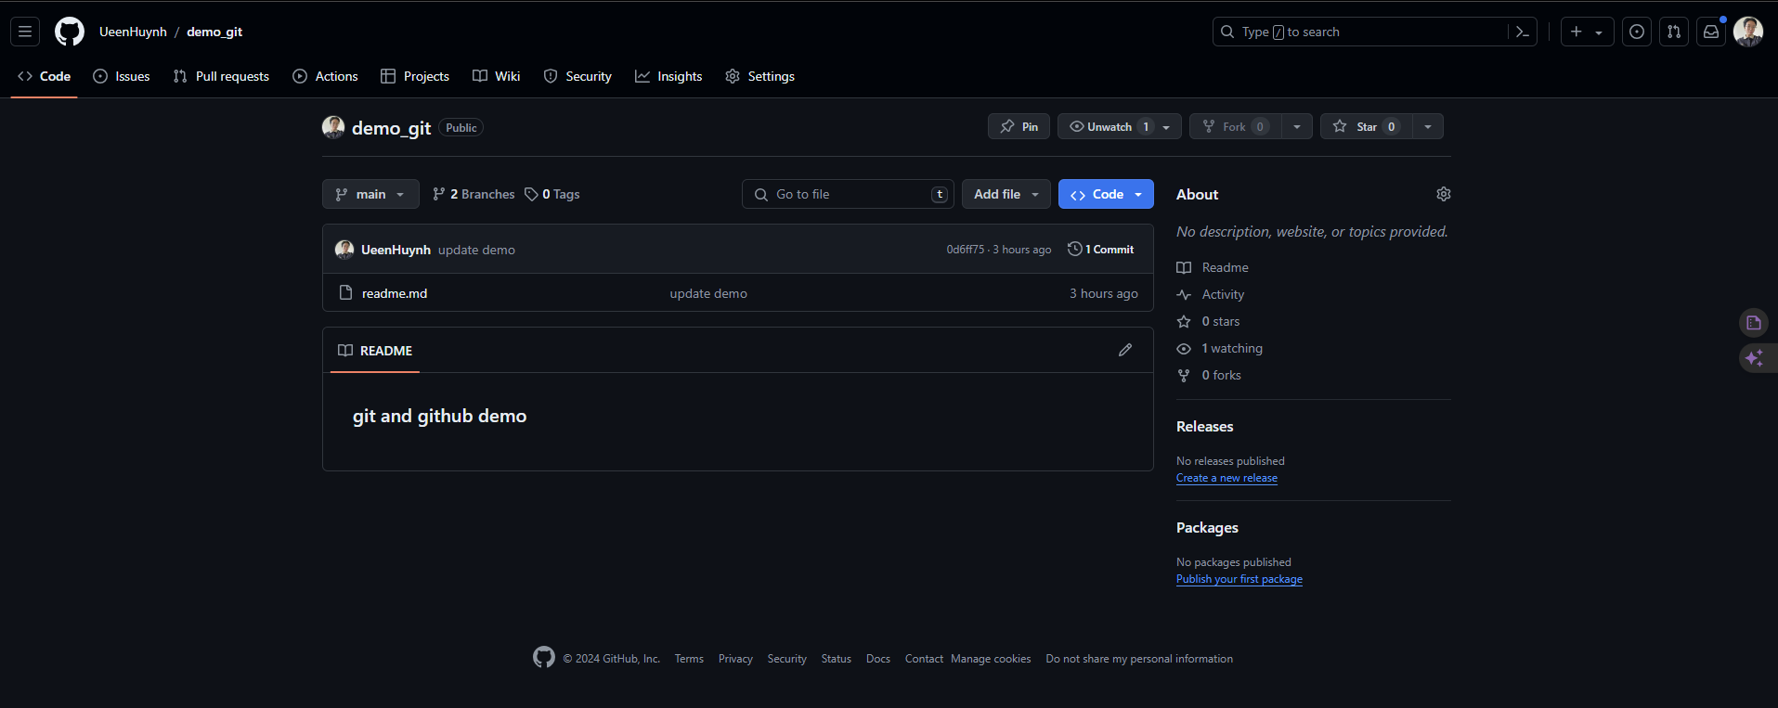
MGMA_2024

Slide 16
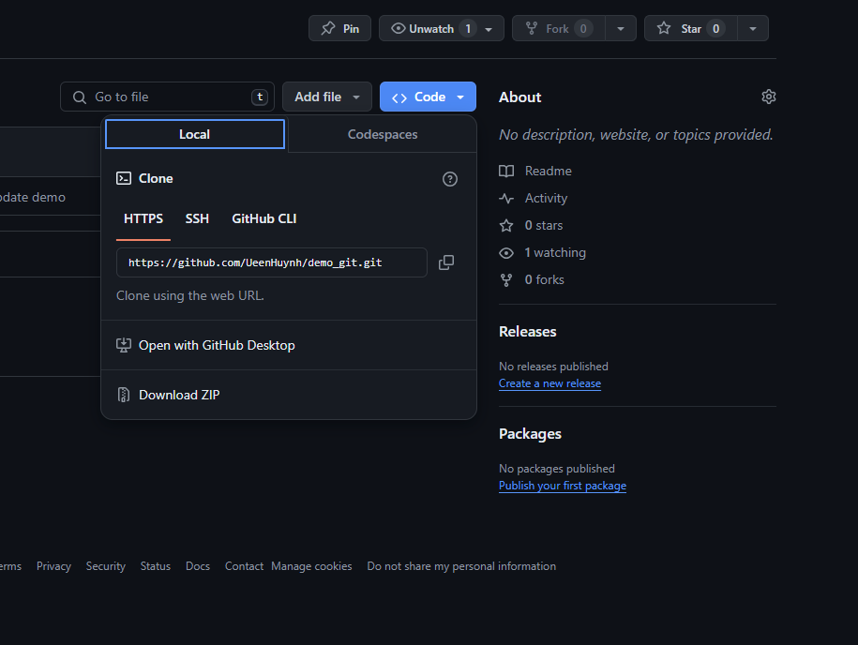

MGMA_2024

Slide 17
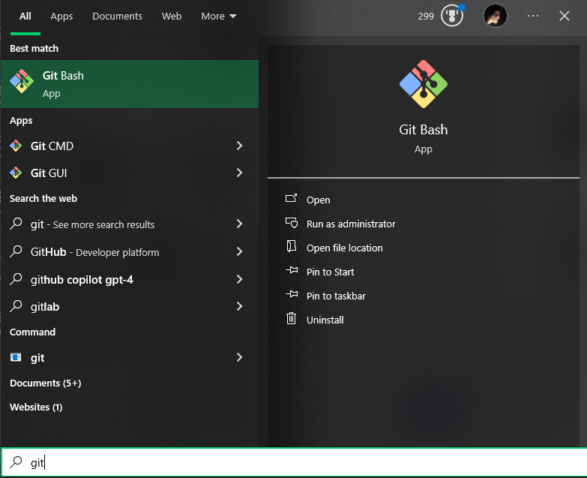
Git and Github instalation
MGMA_2024

Slide 18
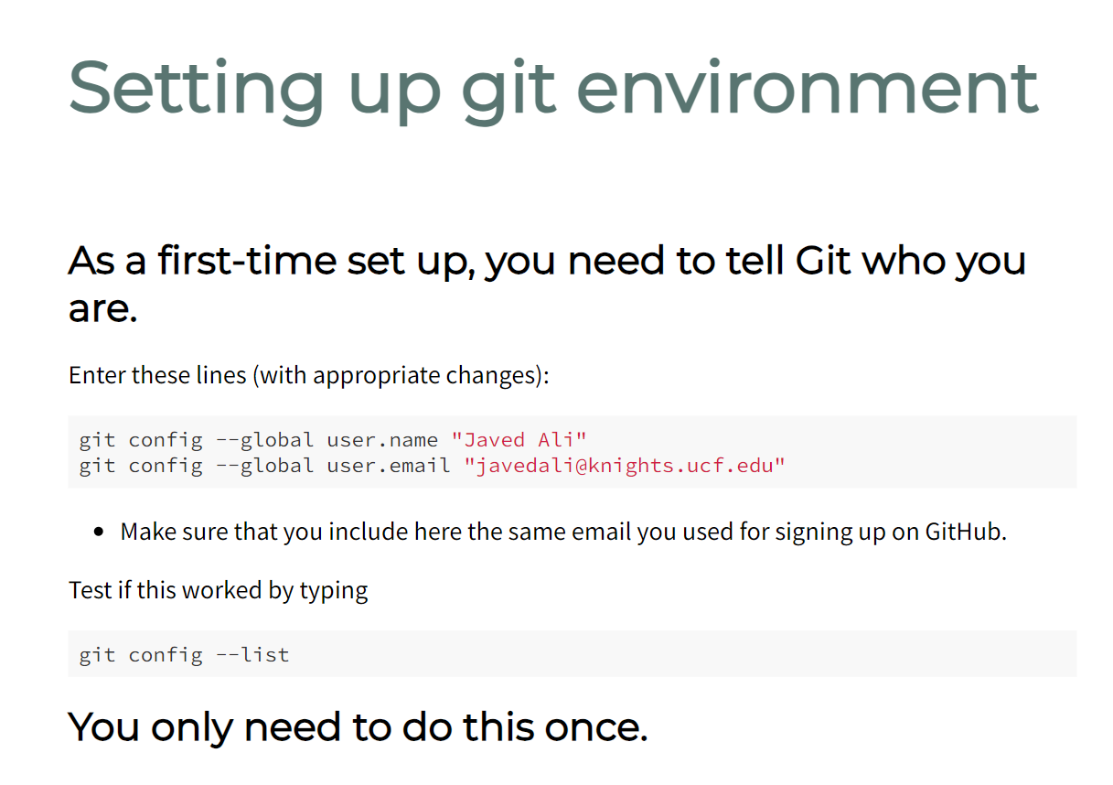

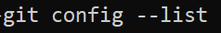
MGMA_2024

Slide 19
Table of Contents
Git and Github introduction
Git and GitHub instalation
Git and VScode
Git Branch
Forking in git
MGMA_2024

Slide 20
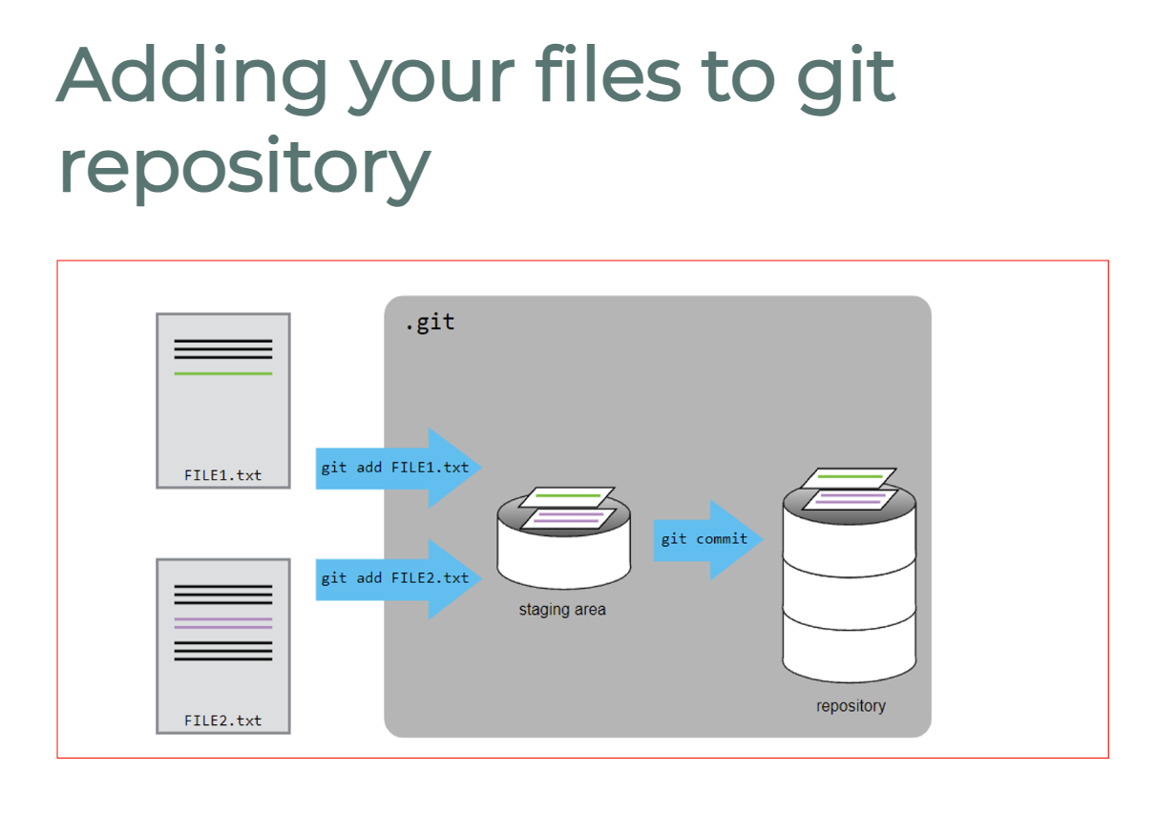
Git and VScode
MGMA_2024

Slide 21
Git and VScode
The basic workflow
First time
Clone the repository that you want to work on from GitHub into your local machine
Work on the files/scripts
Next, you will commit your changes and include an informative message, e.g. "Plot distribution of precipitation"
Then, you will push your changes to the remote repository
Subsequent times
Pull any changes from the remote repository that your collaborators might have made
Repeat steps 2-4 above
MGMA_2024

Slide 22
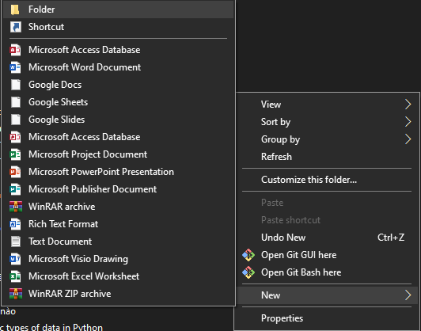
Git and VScode
MGMA_2024

Slide 23
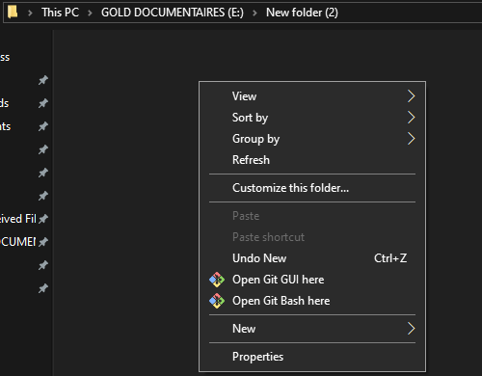
Git and VScode
MGMA_2024

Slide 24
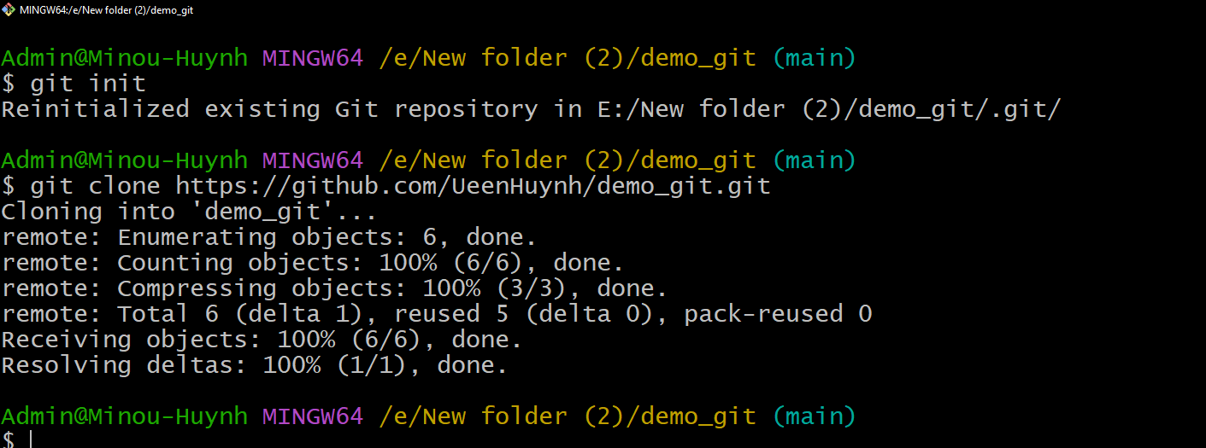
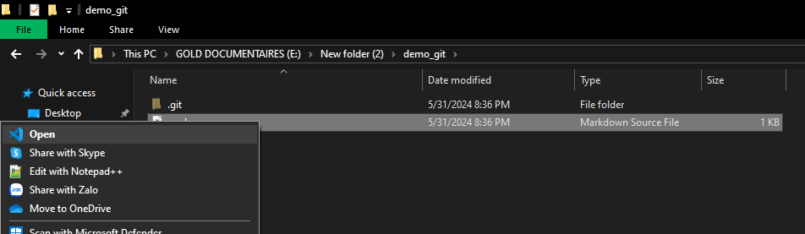
Git and VScode
MGMA_2024

Slide 25
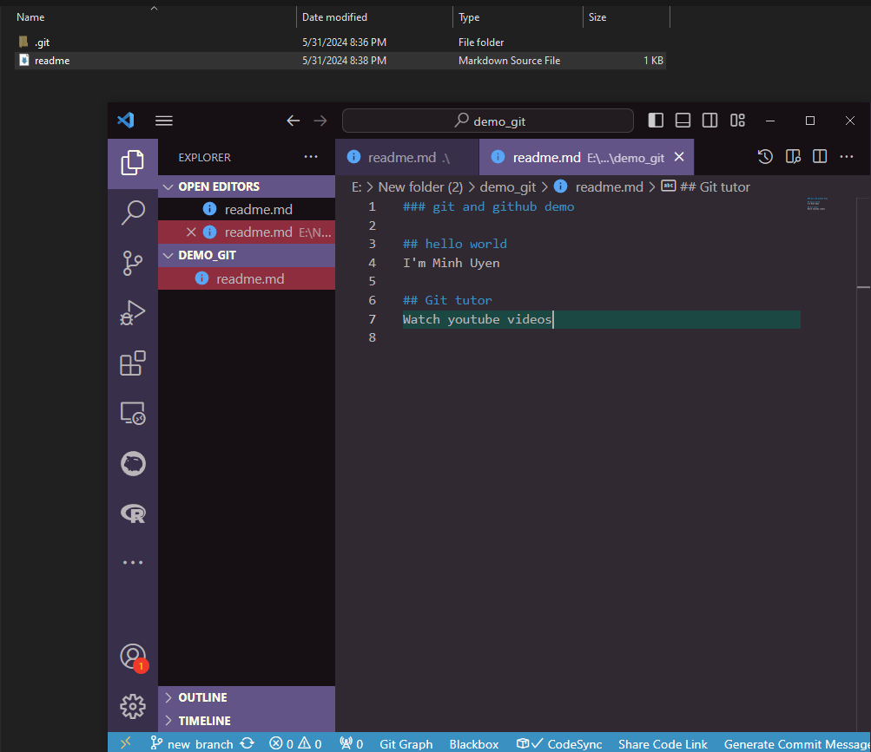

Git and VScode
MGMA_2024

Slide 26
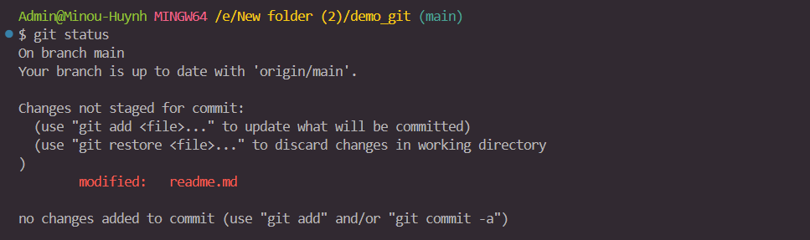
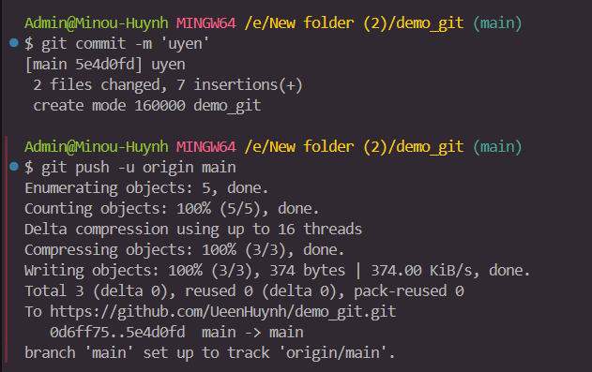
Git and VScode
MGMA_2024

Slide 27
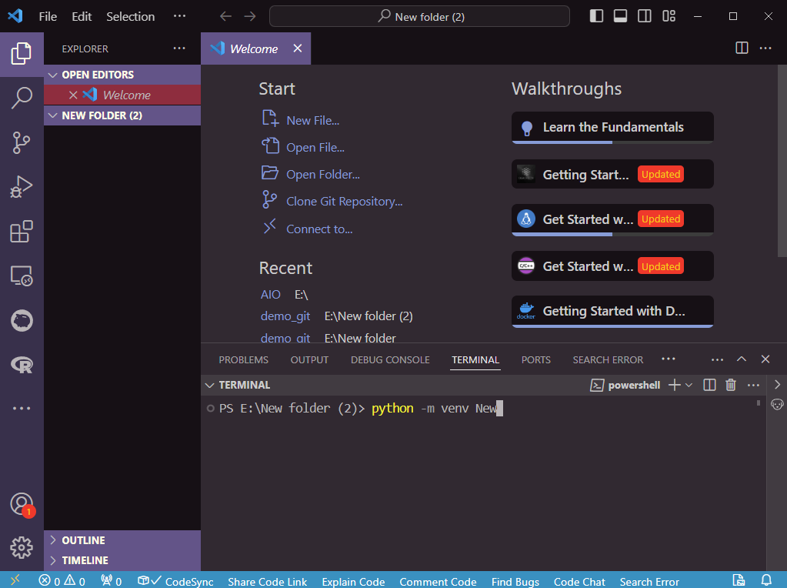

Slide 28
Table of Contents
Git and Github introduction
Git and GitHub instalation
Git and VScode
Git Branch
Forking in git
MGMA_2024

Slide 29

Git branch

Slide 30
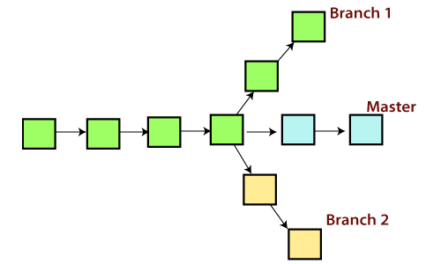
Git branch
Git branch command
git checkout -b feature
git checkout main
git diff
git merge

Slide 31
Table of Contents
Git and Github introduction
Git and GitHub instalation
Git and VScode
Git Branch
Forking in git
MGMA_2024

Slide 32
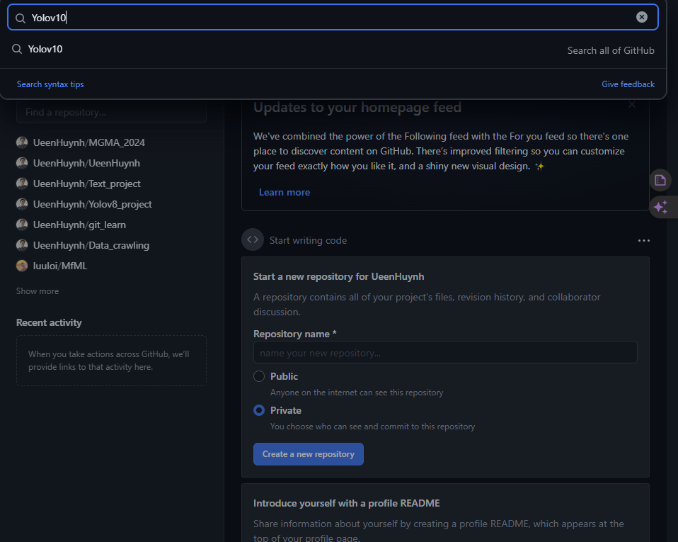
Forking

Slide 33
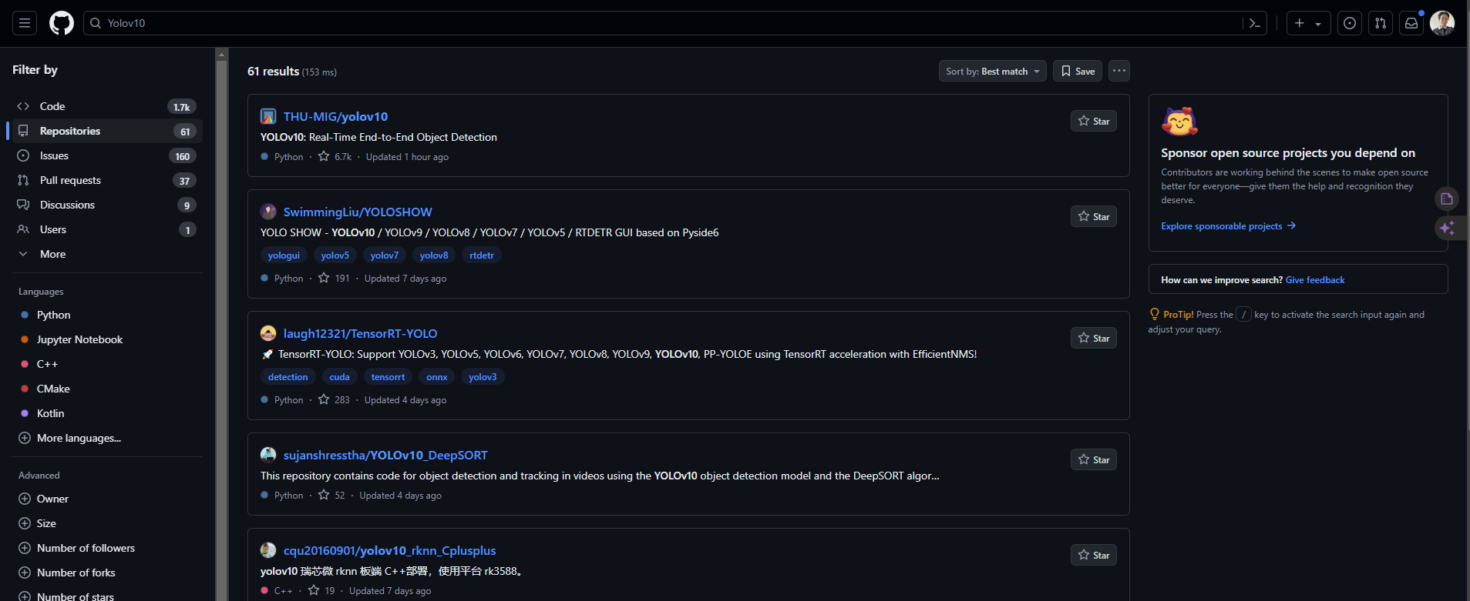
Forking

Slide 34
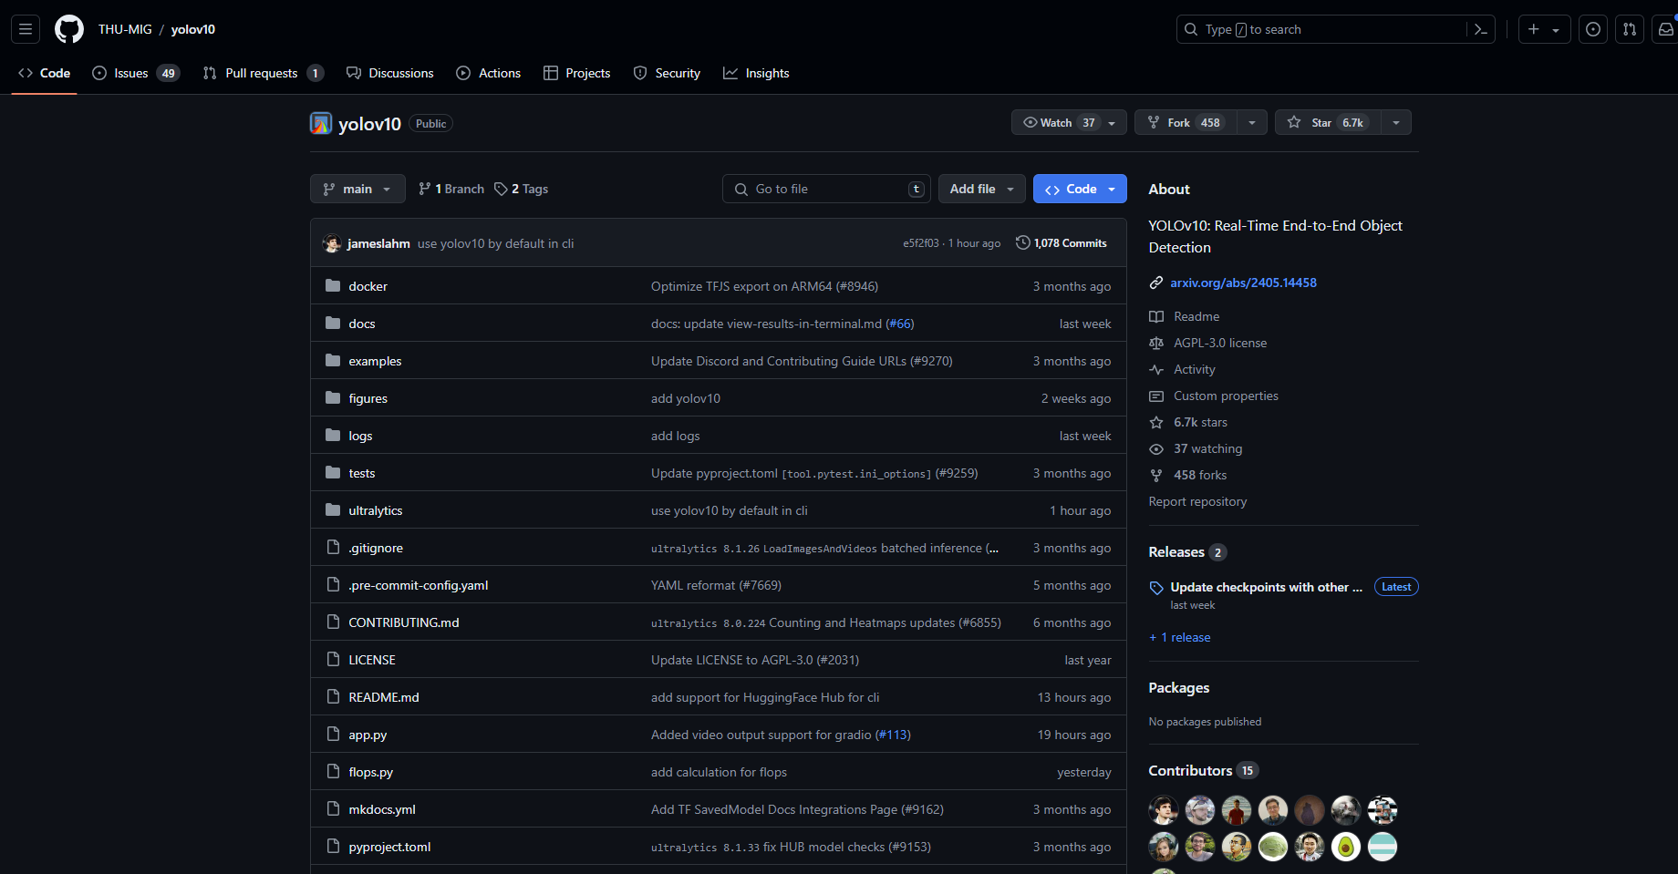
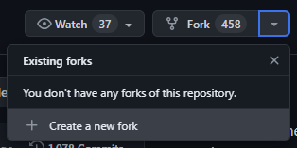
Forking

Slide 35
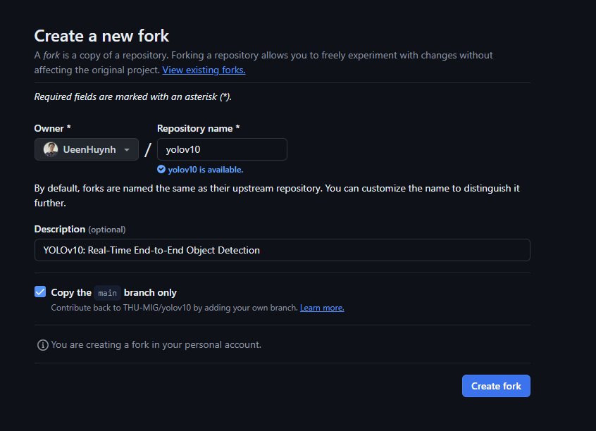
Forking

Slide 36
https://training.github.com/downloads/github-git-cheat-sheet/
https://www.youtube.com/watch?v=RGOj5yH7evk
https://javedali99.github.io/git-tutorial/slides.html
https://gist.github.com/gwenf/19e5748a5391929e8e938a22c8a4b3f2
https://fr.slideshare.net/slideshow/n-mn-hc-ti-tm-hiu-git-v-github/238462540
https://github.com/javedali99/git-tutorial?tab=readme-ov-file
MGMA_2024

